Slide 1
MATLAB lecture
Chapter one: Introduction & definitions Assistant lecture: Jinan N. Shihab
Chapter Three VECTOR AND MATRIX
MATLAB is an abbreviation for "matrix laboratory." While other programming languages mostly work with numbers one at a time, MATLAB is designed to operate primarily on whole matrices and arrays.
  Scalar:-
Any individual real or complex number is represented in MATLAB as a 1-by-1 matrix called a scalar value:
>> x = 23;
To create a 0-by-0 matrix, use the square bracket operators with no value specified: A = [];
whos A
  Vectors:-
A vector is a special form of matrix which contains only one row or one column. A matrix with only one row is called a “row vector” and a matrix with only one column is called a “column vector”. They can be named as one-dimensional arrays.
3.2.1 A row Vector:- A row vector can be created as follows :-
>>x = [1, 3, 7, 9, 20]
x =
Name | Size | Bytes | Class
A | 0x0 | 0 | double array
1 3 7 9 20
>>x = [1 3 7 9 20]
x =
1 3 7 9 20
or can be written:-
3.2.2 A column Vector:- A column vector can be created as follows :- x = [1; 3; 7; 9; 20]
x =
1
3
7
9
20
Note: - suppose that you want to create a vector of values running from 1 to 7, here's how to do it without typing each number jus using colon operator (:)
>> x= [1:7]
x =
1 2 3 4 5 6 7

Slide 2
MATLAB lecture
Chapter one: Introduction & definitions Assistant lecture: Jinan N. Shihab
The increment can be specified as the middle of three argument:-
Name of variable=[ Starting value: increment: last Value]
>> x=[0:2:8]
x =
0 2 4 6 8
Increments can be fractional or negative, as follow:-
>>k =2:-0.5:-1
k =
2 1.5 1 0.5 0 -0.5 -1
Example:-
>> v=[1 2 3 4 5]
v =
1 2 3 4 5
>> length(v) ans =
5
>> v(3)
ans = 3
>> v(5)=500
v =
1 2 3 4 500
>> v([1,3,5])=[-10 -20 -30]
v =
-10 2 -20 4 -30
    Transpose :- to change the vector from row to column or inverse, put a prime (') or single quote after variable like:- y= x'
>> y= x' y =
0
2
4
6
8
    linspace (a,b,n)
This method creates an array with n number of equally spaced values starting from a and ending at b:-
>> x=linspace(0,4,8) x =
0 0.5714 1.1429 1.7143 2.2857 2.8571 3.4286 4.0000

Slide 3
MATLAB lecture
Chapter one: Introduction & definitions Assistant lecture: Jinan N. Shihab
This is useful when we want to divide an interval into a number of subinterval of the same length.
For example, R= linspace(0,2*pi,41) divides the interval [0,2ᴨ] into 40 equal subintervals,
creating a vector of 41 elements.
3.2.5 Vector Algebra:-
Array operations refer to element-by-element arithmetic operations. Preceding the linear algebraic matrix operations, * / \ ‘ , by a period (.) indicates an array or element-by-element operation. Thus, the operators .* , .\ , ./, .^ , represent element-by-element multiplication, left division, right division, and raising to the power, respectively. For addition and subtraction, the array and matrix operations are the same. Thus, + and .+ can be regarded as an array or matrix addition.
3.2.5.1 Equality of Vector:- two vectors are equals even if they have different numbers of elements.
>> x=[1 2 3];
>> y=[4 5 6];
>> x=y x =
4 5 6
3.2.5.2 Addition of Vectors:- You add two
corresponding entries:- Example:-
>> u=1:4
u =
vectors of equal length
by adding the
1 2 3 4
>> v=5:8
v =
5 6 7 8
>> u+v ans =
6 8 10 12
Example:-
>> u=[1,2]’, v=[3,4]’
u = 1
2
v = 3
4
>> u+v ans =
4
6

Slide 4

MATLAB lecture
Chapter one: Introduction & definitions
Assistant lecture: Jinan N. Shihab
Example:-
>> u=1:3
u =
1 2 3
>> v=1:4
v =
1 2 3 4
>> u+v
??? Error using ==> plus Matrix dimensions must agree.
Example:-
>> v=1:3
v =
1 2 3
>> w=v+3
ans =
4 5 6
      Subtraction of Vectors:- You can subtract two vectors if and inly if they have same element numbers.
      Multiplication of Vectors:- You can multiply two vectors if and inly if they have same element numbers and with using dot operator (.) before the operation.
>> u=1:4;
>> v=5:8;
>> u*v
Error using *
Inner matrix dimensions must agree.
>> u.*v ans =
5 12 21 32
>> ans*2
ans =
10 24 42 64
      Division of Vectors:- follow the same rule of multiplication of vectors
>> u./v ans =
0.2000 0.3333
Example:- for scalar
>> u/2 ans =
0.5000 1.0000
0.4286 0.5000
1.5000
2.0000

Slide 5
MATLAB lecture
Chapter one: Introduction & definitions Assistant lecture: Jinan N. Shihab
      Power of Vectors:- follow the same rule of multiplication of vector.
>> u.^v ans =
1 64 2187 65536
For scalar we must use the dot operator
>> u.^3+v.^2 ans =
26 44 76 128
      Square root of Vectors:- no need for dot operator.
>> sqrt(u) ans =
1.0000 1.4142
>> sqrt(v) ans =
2.2361 2.4495
1.7321 2.0000
2.6458 2.8284
Notes :- Matlab has the usual built-in function, such as sin, cos…etc, these functions can take matrices as arguments, in which case the function is applied to each element of the matrix.
Create a script file(M-file) with the following code: Example
A = [7, 11, 15, 23, 9];
B = [2, 5, 13, 16, 20]; C = A + B;
D = A - B;
disp(C);
disp(D);
Example
v = [ 12 34 10 8];
m = 5 * v Example
r = [ 1 2 3 4 ];
tr = r';
v = [1;2;3;4];
tv = v'; disp(tr);
disp(tv);
Example
r1 = [ 1 2 3 4 ];
r2 = [5 6 7 8 ];
r = [r1,r2] rMat = [r1;r2]

Slide 6
MATLAB lecture
Chapter one: Introduction & definitions
Assistant lecture: Jinan N. Shihab
c1 = [ 1; 2; 3; 4 ];
c2 = [5; 6; 7; 8 ];
c = [c1; c2] cMat = [c1,c2]
Example:-
v = [1: 2: 20];
sv = v.* v; %the vector with elements
% as square of v's elements
dp = sum(sv); % sum of squares -- the dot product mag = sqrt(dp); % magnitude
disp('Magnitude:'); disp(mag);
3.2.3 Built in functions used in vectors:-
Let x=[3 5 8 4 2]
Function | Meaning | Example in vector
max | Largest component. | >> max(x) ans = 8
mean | Average or mean value. | >> mean (x) ans = 4.4000
sort | Sort in ascending order. | >> sort(x) ans = 2 3 4 5 8
sum | Sum of elements. | >> sum(x) ans = 22
prod | Product of elements. | >> prod(x) ans = 960
diff | Difference and approximate derivative. | >> diff(x) ans = 2 3 -4 -2
Size | Get the size (number of row or column) | >> size(x) ans = 1 5
Also one of the vector application is to finding the roots of any polynomials.
Example:- solve the quadratic equation 2S²+10S+12=0 by using roots function?
>> p=[2 10 12];
>> s=roots(p) s =
-3.0000
-2.0000
H.W:- find the root of the polynomial below:-
Diyala university- College of Engineering

Slide 7
MATLAB lecture
Chapter one: Introduction & definitions Assistant lecture: Jinan N. Shihab
5 x⁵+ 4x⁴-3x³+2x²+x+1=0
3.3 Matrices:-
A matrix is a rectangular multidimensional array of numbers. Row and column vectors, are example of matrices.
>> X = [1,2,3;4,5,6;7,8,9] X =
1 | 2 | 3
4 | 5 | 6
7 | 8 | 9
The elements in arrow can also be separated by spaces:-
>> X = [1 2 3;4 5 6;7 8 9] X =
1 | 2 | 3
4 | 5 | 6
7 | 8 | 9
Example:-
>> A=magic(4) A =
16 | 2 | 3 | 13
5 | 11 | 10 | 8
9 | 7 | 6 | 12
4 | 14 | 15 | 1
>> size(A) ans =
4 4
>> A(2,3)
ans =
10
>> A(2,:)
ans =
5 11 10 8
>> A(:,2)
ans =
2
11
7
14
>> A([1,3],[2,4])
ans =
2
13

Slide 8
MATLAB lecture
Chapter one: Introduction & definitions
7 12
>> A(3,4)=12 A =
Assistant lecture: Jinan N. Shihab
16 | 2 | 3 | 13
5 | 11 | 10 | 8
9 | 7 | 6 | 12
4 | 14 | 15 | 1
>> A(:,2)=11 A =
16 | 11 | 3 | 13
5 | 11 | 10 | 8
9 | 11 | 6 | 12
4 | 11 | 15 | 1
>> A.'
ans =
16 | 5 | 9 | 4
11 | 11 | 11 | 11
3 | 10 | 6 | 15
13 | 8 | 12 | 1
3.3.1 Matrix Algebra:-
3.3.1.1 Equality of Matrices:- two matrices are equal even if they have different size.
>> E = [7 2 3; 4 3 6; 8 1 5];
F = [1 4 2; 6 7 5; 1 9 1];
>> E=F E =
1 | 4 | 2
6 | 7 | 5
1 | 9 | 1
3.3.1.2 Addition of Matrices:- If two matrices have the same dimension, then add the matrices by adding the corresponding entries in each matrix.
>>A=[1 1 1;2 2 2;3 3 3]; B=[1 1 1;1 1 1;1 1 1];
>>A+B
ans=
2 | 2 | 2
3 | 3 | 3
4 | 4 | 4
You can also add a scalar ( a single number) to a matrix A

Slide 9
MATLAB lecture
Chapter one: Introduction & definitions
Assistant lecture: Jinan N. Shihab
A=[1 1 1;2 2 2;3 3 3]
>>A+1
ans=
2 | 2 | 2
3 | 3 | 3
4 | 4 | 4
3.3.1.3 Subtraction of Matrices:- the same rules must match with matrix subtraction process.
>>A-B
= ans
0 | 0 | 0
1 | 1 | 1
2 | 2 | 2
3.3.1.4 Multiplication of Matrices:- if A and B are multiplicatively compatible , if A is n×M and B is m×1, then their product A*B is n×1.( there are the same number of column in A as there is rows in B).
>>A*B
ans=
3 | 3 | 3
6 | 6 | 6
9 | 9 | 9
Also we can multiply a scalar by a matrix A
>> 12*A
ans =
12 | 12 | 12
24 | 24 | 24
36 | 36 | 36
Create a script file with the following code:
Example
a = [ 1 2 3 ; 4 5 6; 7 8 9];
b = [ 7 5 6 ; 2 0 8; 5 7 1];
c = a / b d = a \ b
Example:-
a = [ 10 12 23 ; 14 8 6; 27 8 9];
9

Slide 10
MATLAB lecture
Chapter one: Introduction & definitions
Assistant lecture: Jinan N. Shihab
b = 2;
c = a + b d = a - b
e = a * b f = a / b
3.3.1.5 built- in function used in matrixes:-
>> B=magic(3) B =
8 | 1 | 6
3 | 5 | 7
4 | 9 | 2
max | Largest component in each column. | >> max(B) ans = 8 9 7
mean | Average or mean value of each column. | >> mean(B) ans = 5 5 5
sort | Sort in ascending order of each column. | >> sort(B) ans = 3 1 2 4 5 6 8 9 7
sum | Sum of elements in each column. | >> sum(B) ans = 15 15 15
prod | Product of elements of each column. | >> prod(B) ans = 96 45 84
det | Get the determine of the matrix B | > det(B) ans = -360
diag | To call the main diagonal of matrix | >> diag(B) ans = 8 5 2
trace | To sum of the main diagonal of matrix | >> trace(B) ans = 15
inv | To inverse the matrix | >> inv(B) ans = 0.1472 -0.1444 0.0639 -0.0611 0.0222 0.1056 -0.0194 0.1889 -0.1028
10

Slide 11
MATLAB lecture
Chapter one: Introduction & definitions
Assistant lecture: Jinan N. Shihab
eig | To finds the eigenvalues of a | >> eig(B)
 | matrix | ans =
 |  | 15.0000
 |  | 4.8990
 |  | -4.8990
zeros | Create a matrix of all zeros. | >> zeros(2,2) ans = 0 0 0 0
ones | Create a matrix of all ones. | >> ones(2,2) ans = 1 1 1 1
eye | identity matrix returns an m x n | >> eye(2,2)
 | matrix with ones on the main | ans =
 | diagonal and zeros elsewhere. | 1 0
 |  | 0 1
rand | Generated randam number | >> rand(2,2) ans = 0.814723686393179 0.905791937075619 | 0.126986816293506 0.913375856139019
3.4 Solving System of Equation:-
Mathematically Cramer’s Rule:-
For the system of equation:-
�₁₁� + �₁₂� = �₁
d= det A =|_{�21}
�11 �12
�22|
�₁
�12
�22
11
� |
=|
�₂
|
=|�
1
�₂₁� + �₂₂� = �₂ � =
𝑑
� =
�21
𝑑
�₂
By using MATLAB program:-
>>𝐴= [�₁₁ �₁₂; �₂₁�₂₂];
d= det A;
>> 𝐴2 = [�₁ �₁₂; �₂ �₂₂];
≫ � =
det(𝐴1)
𝑑
≫ � = det(𝐴2) /𝑑
Example:- solve the system:- 3x-y=9
X+2y=-4

Slide 12
MATLAB lecture
Chapter one: Introduction & definitions
Assistant lecture: Jinan N. Shihab
Solution:-
>> A=[3 -1;1 2]; d=det(A)
d =
7
>> A1=[9 -1;-4 2];
>> A2=[3 9;1 -4];
>> x=det(A1)/d x =
2
>> y=det(A2)/d y =
-3
Example (2):- solve the system:- 10x1 − 7x2 = 7
−3x1 + 2x2 + 6x3 = 4 5x1 − x2 + 5x3 = 6
Solution:-
>> A=[10 -7 0;-3 2 6;5 -1 5]; d=det(A)
d =
-155.0000
>> A1=[7 4 6;-3 2 6;5 -1 5];
>> A2=[10 -7 0;7 4 6;5 -1 5];
>> A3=[10 -7 0;-3 2 6;7 4 6];
>> x=det(A1)/d x =
-1.6129
>> y=det(A2)/d y =
-1.9032
>> z=det(A3)/d z =
3.4839
Another solution by using (matrix inverse)
>> A=[10 -7 0;-3 2 6;5 -1 5] A =
10 | -7 | 0
-3 | 2 | 6
5 | -1 | 5
>> B=inv(A)

Slide 13
MATLAB lecture
Chapter one: Introduction & definitions
Assistant lecture: Jinan N. Shihab
B =
-0.1032 | -0.2258 | 0.2710
-0.2903 | -0.3226 | 0.3871
0.0452 | 0.1613 | 0.0065
>> c=[7;4;6];
>> x=B*c x =
0
-1.0000
1.0000
3.5 MATLAB Function:- MATLAB basically has two kinds of function numerical functions and symbolic expressions of function. There are two methods to define your numerical function in MATLAB. The first uses the command inline, and the second uses the operator
@ to creat what is called an “ anonymous function” . the latter method is new in MATLAB 7.
Here’s how to define the function f(x)=x² using these commands
>>f=@(x)x^2 f=
@(x)x^2
Alternatively, inline function:
>>f1=inline(‘x^2’,’x’) f1 =
Inline function: f1(x) = x^2
once the function is defined-by either method-you can evaluate it:
>> f(4)
ans =
16
>> f1(4)
ans =
16
Most MATLAB function can operate on vectors as well as scalars. To insure that your user- defined function can act on vectors, insert dots before the mathematical operators *,/,and ^.
>> f=@(x) x.^2 Or else
>> f1=inline(‘ x.^2’,’x’)
Now we can evaluate either function on a vector, for example:-
>>f(1:5)
ans =

Slide 14
MATLAB lecture
Chapter one: Introduction & definitions
1 4 9 16 25
Assistant lecture: Jinan N. Shihab
Or if A is amatrix with element 𝐴= [
2
5 4
8 − 9𝑗2𝑗]
3 + 6𝑗
>>A=[2 5 4; 3+6j 8-9j 2j]; B=f1(A) B=
1.0e+002
Example:- if g(x,y)=x²+y² find
The value of g at the point (1,2).
The value of g at the point (1,3) and (2,4). Solution:-
>> g=@(x,y) x^2+y^2;
>> g(1,2)
ans =
5
>> g1=inline('x.^2+y.^2','x','y');
>> g1([1 2],[3 4])
ans =
10 20
0.0400 | 0.2500 | 0.1600
-0.2700+0.3600i | -0.1700-1.4400i | -0.0400
3.5.1 Symbolic Summation
You can compute symbolic summations, when they exist, by using the symsum command. For example, the p-series
1 1
1 + + + ⋯
₂2 ₃2
sums to 𝜋²/6 , while the geometric series
1 + x + x² + ...
sums to 1/(1 – x), provided |x| < 1 . These summations are demonstrated below:-
�
Example:- find 1) ∑∞ and 2)∑∞
_{𝒙}𝒌
𝒊=� _{𝒊}�
𝒌=�
Solution:-
>>syms x k
>>s1 = symsum(1/k^2, 1, inf)
>>s2 = symsum(x^k, k, 0, inf) s1 =
pi^2/6 s2 =
piecewise([1 <= x, Inf], [abs(x) < 1, -1/(x - 1)])
3.5.2 Numerical integration:-

Slide 15
MATLAB lecture
Chapter one: Introduction & definitions Assistant lecture: Jinan N. Shihab
Not every function can be symbolically integrated, and so numerical integration is sometimes necessary . Mtlab has command ( trapz) which coping trapezoidal rule and (quad) which coping simpson’s rule for numerical integration of function f(x).
Example:- compare the analytical and numerical evaluation of the area under the curve defined by the function y= x² in the interval 0 ≤ � ≤ 4 using both trapenzoidal command and
quadrature command.
Solution :-
>> format long
>> syms x
>> y=int(x^2,0,4) y =
64/3
>> double(y) ans =
21.333333333333332
>> vpa(y) ans =
21.333333333333333333333333333333
By using trapz function:-
>> x=[0:0.001:4];
>> y=x.^2;
>> trapz(x,y) ans =
21.333333999999997
>> vpa(ans) ans =
21.3333339999999971325905789854
By using quad function:-
The quadrature command requires the definition of the function:-
>> f=inline('x.^2');
>> quad(f,0,4) ans =
21.333333333333332
>> vpa(ans) ans =
21.333333333333333333333333333333
3.6 Solve an Equation:-
If eqn is an equation, solve(eqn, x) solves eqn for the symbolic variable x. Use the == operator
to specify the familiar quadratic equation and solve it using solve.

Slide 16
MATLAB lecture
Chapter one: Introduction & definitions Assistant lecture: Jinan N. Shihab
>>syms a b c x
>>eqn = a*x^2 + b*x + c == 0;
>>solx = solve(eqn, x) solx =
-(b + (b^2 - 4*a*c)^(1/2))/(2*a)
-(b - (b^2 - 4*a*c)^(1/2))/(2*a)
solx is a symbolic vector containing the two solutions of the quadratic equation. If the input eqn is an expression and not an equation, solve solves the equation eqn == 0. To solve for a variable other than x, specify that variable instead. For example, solve eqn for b.
>>solb = solve(eqn, b) solb =
-(a*x^2 + c)/x
If you do not specify a variable, solve uses symvar to select the variable to solve for. For example, solve(eqn) solves eqn for x.
Example:- find the solutions of the quadration equation �² − 2� − 4 = 0, by using solve function
Solution:-
>> solve('x^2-2*x-4=0') % or solve(‘x^2-2*x=4’) ans =
5^(1/2) + 1
1 - 5^(1/2)
To get numerical solution:-
>> double(ans) ans =
3.236067977499790
-1.236067977499790
Or
>> vpa(ans) ans =
3.2360679774997898050514777423814
-1.2360679774997898050514777423814
Example:- find the solutions of the quadratic �² − 3� = −7, by using solve function. Solution:-
>> syms x
>> x^2-3*x+7;
>> solve(ans) ans =
(19^(1/2)*i)/2 + 3/2 3/2 - (19^(1/2)*i)/2

Slide 17
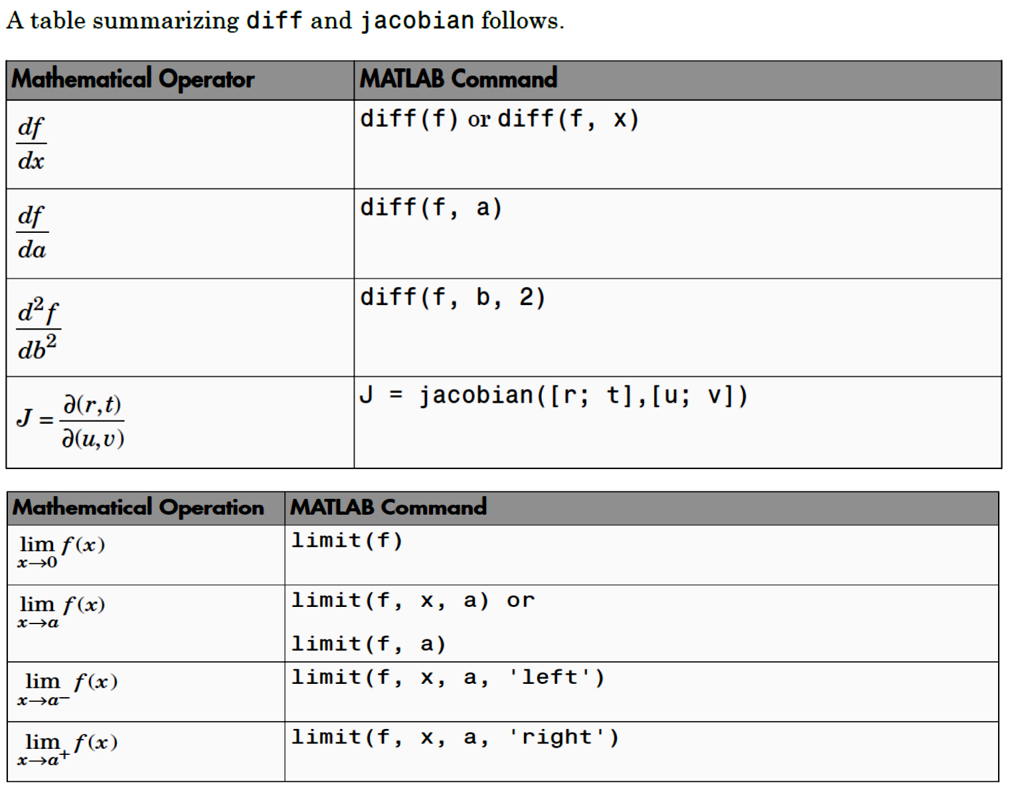
MATLAB lecture
Chapter one: Introduction & definitions Assistant lecture: Jinan N. Shihab
Example:- solve y in term of x for the following equation 2� − ln(�) = 1
>> solve('2*x-log(y)=1','y') ans =
exp(2*x - 1)
and if we want to solve x in term of y:-
>> solve('2*x-log(y)=1','x') ans =
log(y)/2 + ½
Example:- find the value of x and y from the following equation
� + 2� = 4, 2� − � = 3
Solution:-
>> [x,y]=solve('x+2*y=4','2*x-y=3') x =
2
y = 1

Slide 18
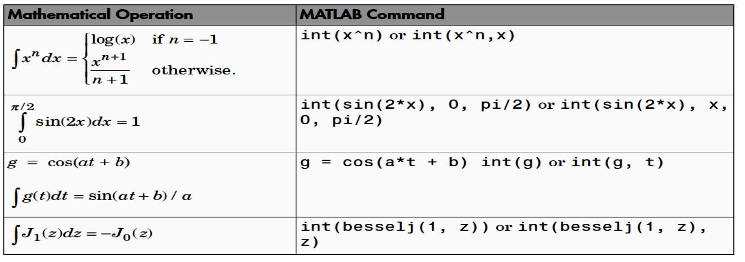
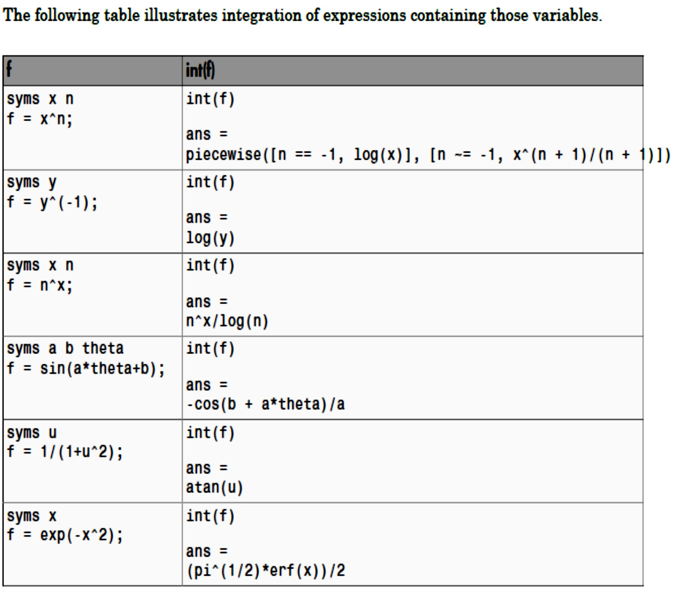
MATLAB lecture
Chapter one: Introduction & definitions
Assistant lecture: Jinan N. Shihab

Slide 19
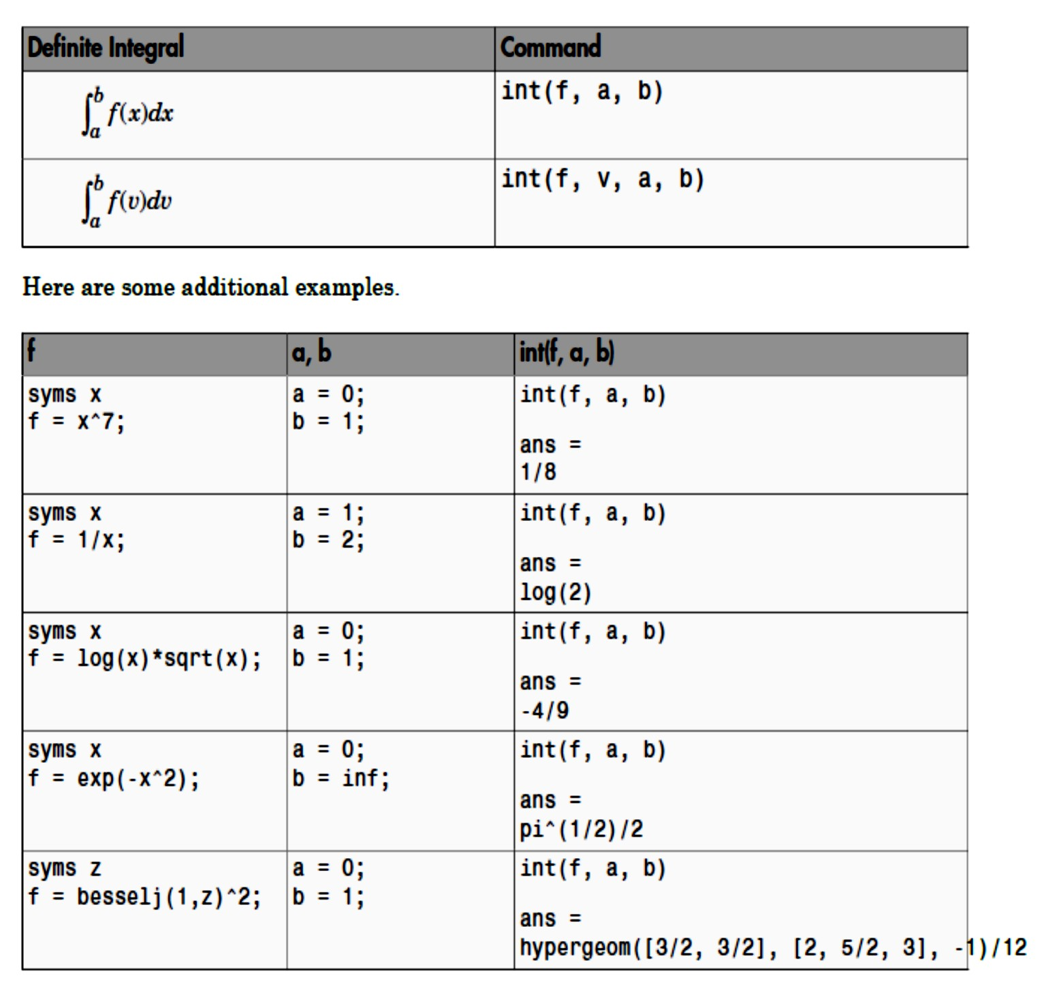
MATLAB lecture
Chapter one: Introduction & definitions
Assistant lecture: Jinan N. Shihab

